Slide 1
Visualizing employing attendance trends using an excel sheet
STUDENT NAME: DIVYA DHARSHINI K
REGISTER NO: 322188168
NM ID: B306348CECC2D19BA6F43246C0E853B2
DEPARTMENT: B.COM (BANK MANAGEMENT)
COLLEGE: AVICHI COLLEGE OF ARTS AND SCIENCE

Slide 2
PROJECT TITLE
Visualizing employing attendance trends using an excel sheet

Slide 3


AGENDA
Problem Statement
Project Overview
End Users
Our Solution and Proposition
Dataset Description
Modelling Approach
Results and Discussion
Conclusion
3/21/2024 Annual Review

Slide 4

PROBLEM STATEMENT
Difficulty in tracking and understanding attendance patterns
Inefficient use of time and resources due to lack of insight Need for a data-driven approach to inform HR and management decisions

Slide 5

PROJECT OVERVIEW
Title: Visualizing Employee Attendance Trends Objective: To create a clear and actionable visualization of employee attendance trends using Excel

Slide 6

WHO ARE THE END USERS?
HR personnel Management team Department supervisors

Slide 7

OUR SOLUTION AND ITS VALUE PROPOSITION
Our Solution
Create an Excel sheet to collect and analyze attendance data Develop visualizations (charts, graphs, etc.) to illustrate attendance trends
Proposition
By using our Excel-based visualization tool, end users will be able to: - Easily track and understand attendance trends - Identify areas for improvement - Make data-driven decisions to optimize attendance and resource allocation - Enhance overall productivity and efficiency

Slide 8
Dataset Description
Attendance data for employees over a specified period (e.g., months, years) Variables: - Employee ID - Date - Attendance status (present, absent, late, etc.) - Department - Job role - Other relevant factors (e.g., weather, holidays, etc.)

Slide 9
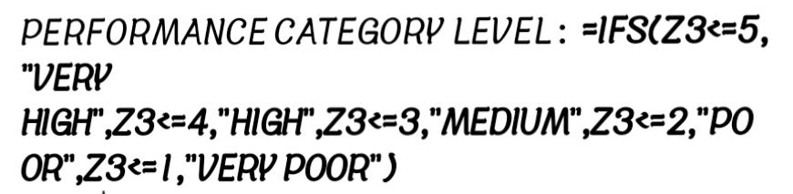

THE "WOW" IN OUR SOLUTION
3/21/2024 Annual Review
9

Slide 10
MODELLING
Data cleaning and preprocessing
Exploratory data analysis (EDA) to understand attendance pattern
Visualization techniques: Time series plots to show attendance trends over time Bar charts to compare attendance rates across departments and job roles Heatmaps to identify correlations between attendance and other factors Scatter plots to show relationships between attendance and continuous variables
10

Slide 11
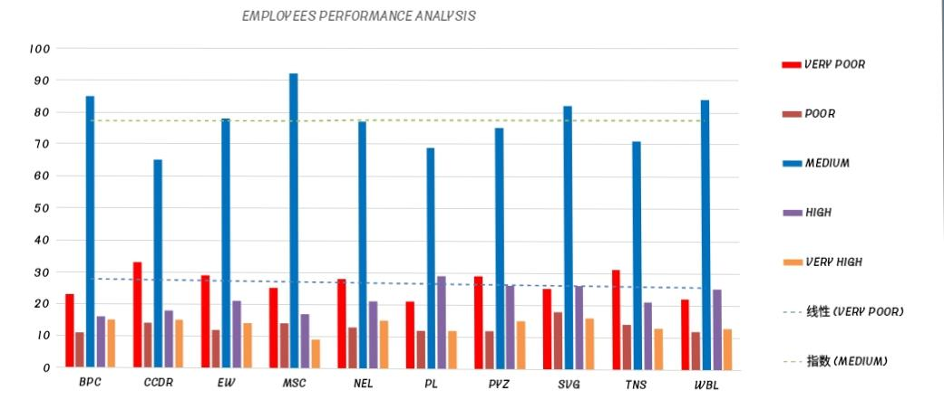
RESULTS
11

Slide 12
conclusion
Summary of key findings from the attendance trend visualization project Main insights gained from the analysis and visualization of attendance data Impact of the project on HR and management decision-making Benefits of using data visualization to understand attendance trends, such as: Improved attendance tracking and monitoring Enhanced insight into attendance patterns and trends Data-driven decision-making for HR and management Identification of areas for improvement and optimization

